Slide 1
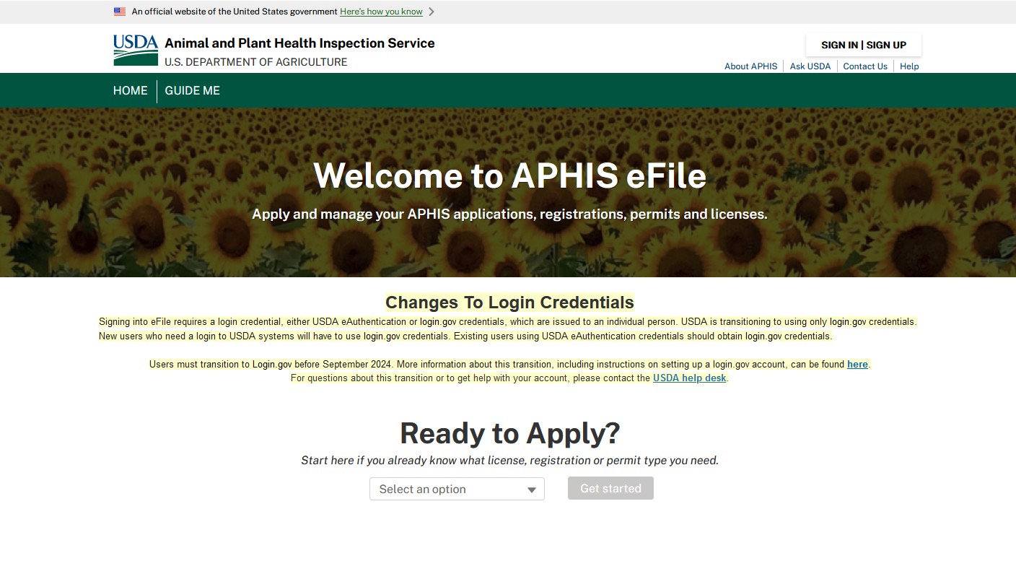
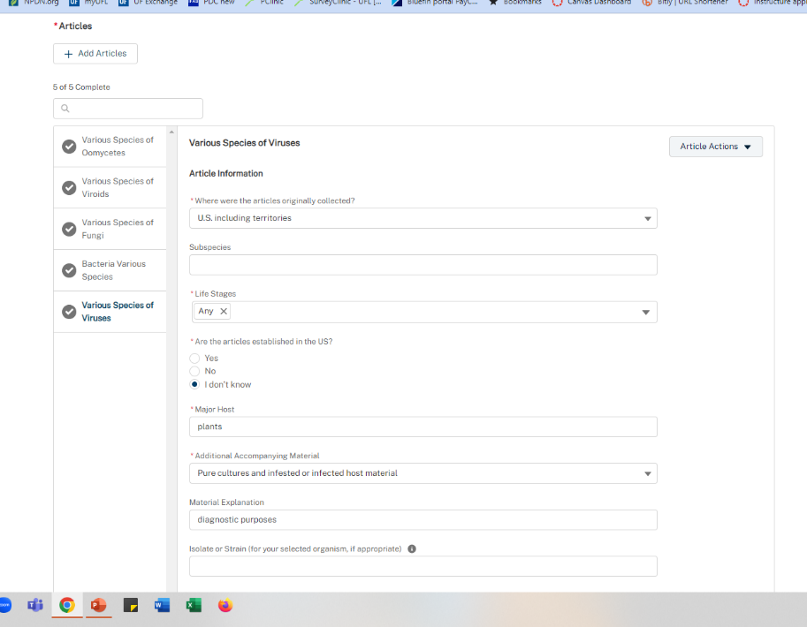
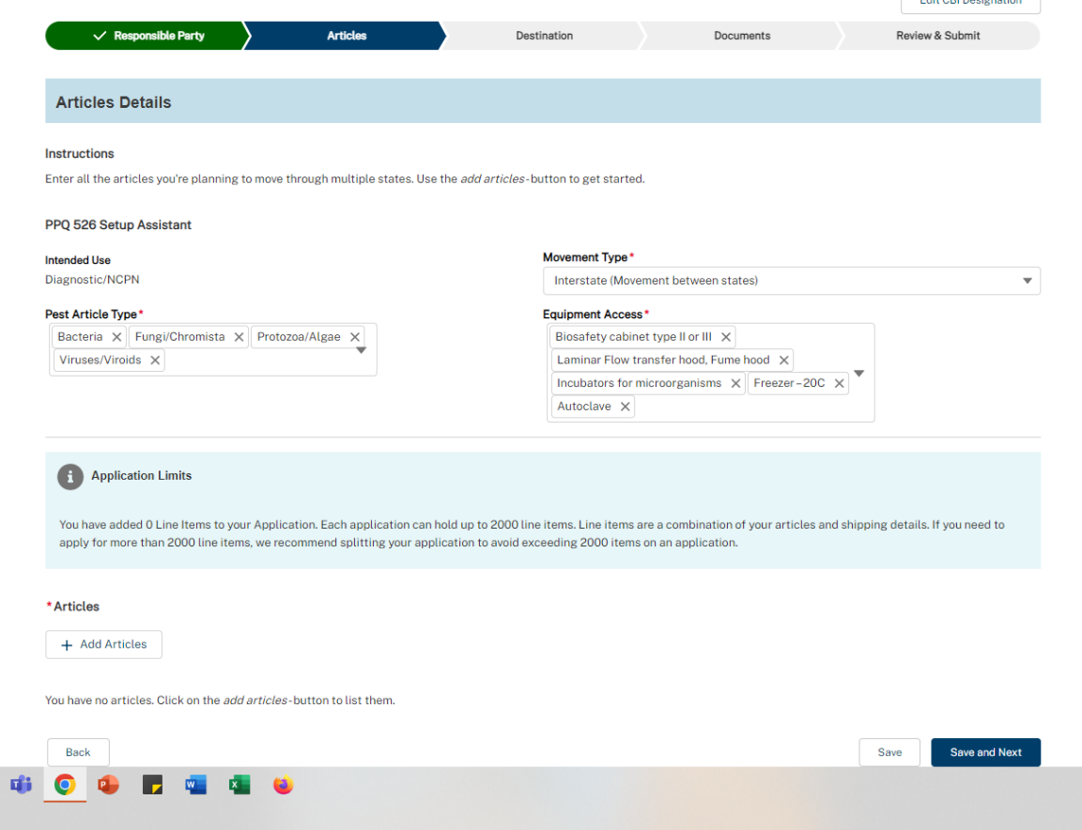
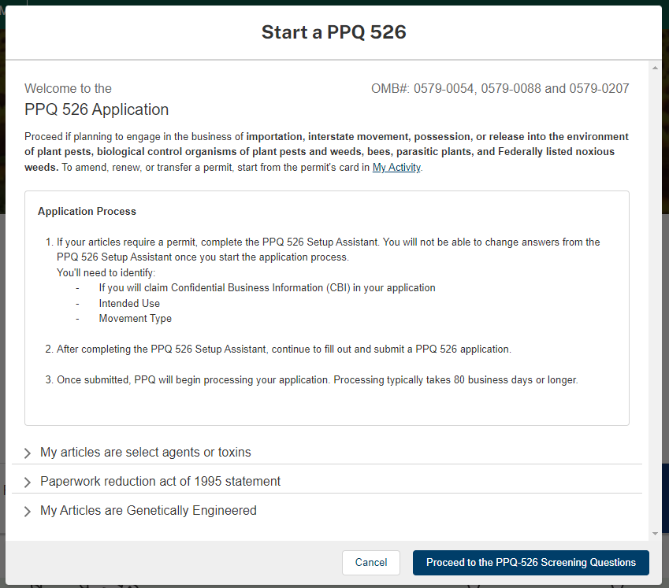
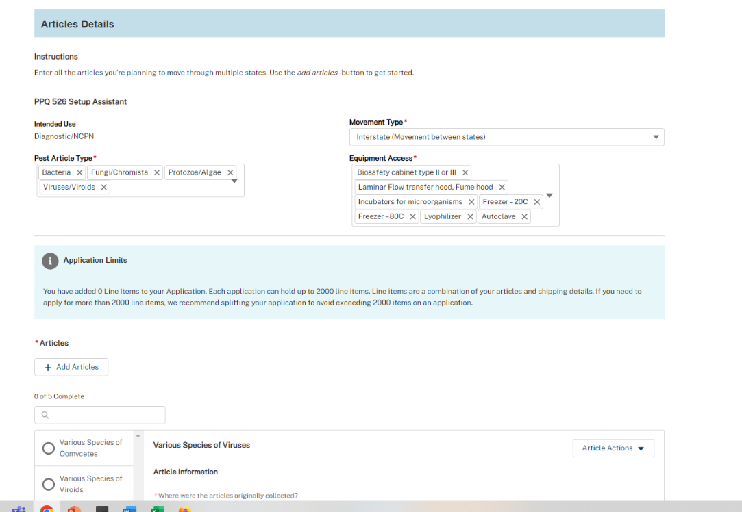
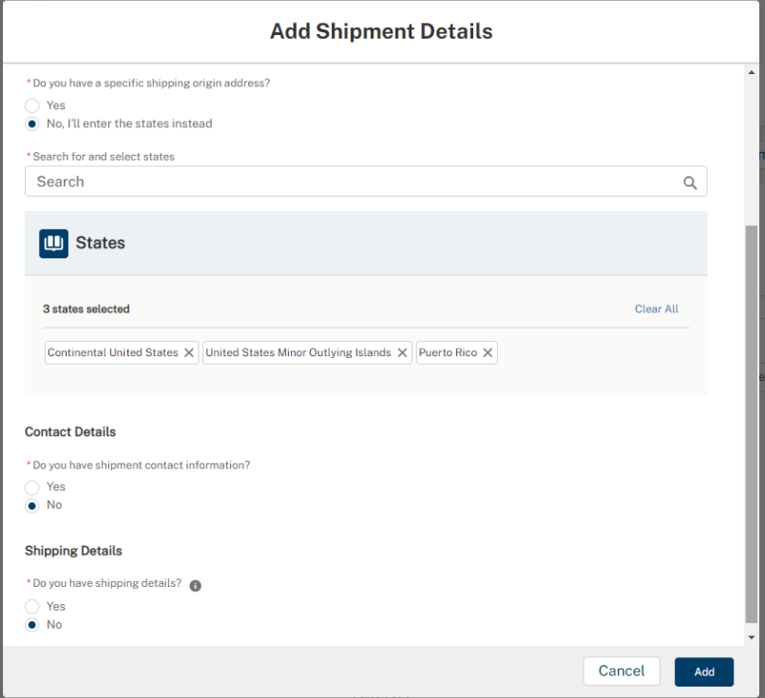
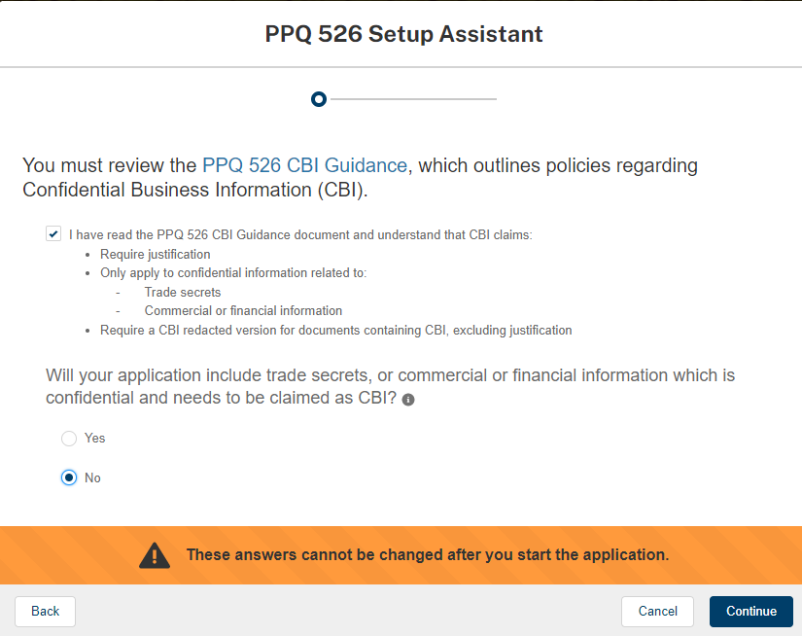
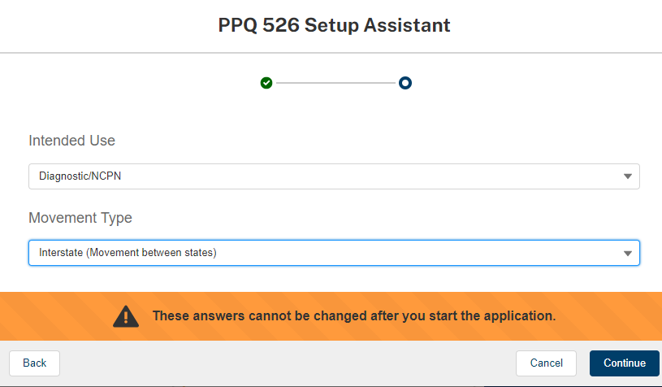
eFile and permits for NPDN labs: a diagnostician’s resource to understanding PPQ permits and applying for a PPQ 526 permit using the eFile system
Carrie Harmon (1), Sam Fieweger (2), Elizabeth Dorman (3), Jen Olson (4)
(1) University of Florida Gainesville, Florida; (2) Wisconsin Department of Agriculture, Trade and Consumer Protection, Madison, Wisconsin; (3) Michigan Department of Agriculture and Rural Development, Lansing, Michigan; (4) Oklahoma State University, Stillwater, Oklahoma
Purpose
Which Permits Do I Need?
The eFile and Permits for NPDN Labs is an online resource created by NPDN Regulatory Relations Committee members to help diagnosticians understand Plant Protection and Quarantine (PPQ) permits and how to apply for a PPQ 526 permit using the USDA’s new eFile system.
This online resource and the 2023 Great Plains Plant Network webinar “PPQ 526 Permits: The Who, What, Why and How of Diagnostic Permits” with Deric Picton are available for use on the NPDN webpage.
The number and type of permits your lab may need will depend on a couple of factors.
Do you accept samples from out-of-state?
Do you use positive control material (not extracted DNA or RNA) which originated from outside your state?
If you answered yes, to either of these questions, you would need a USDA permit.
To accept out-of-state samples your laboratory will need a PPQ 526 Permit.
A PPQ 526 permit is required for the importation, interstate movement and environmental release of plant pests (plant feeding insects, mites, snails, slugs, and plant pathogenic bacteria, viruses, fungi, etc.), biological control organisms of plant pests and weeds, bees, parasitic plants, and Federally listed noxious weeds.
To use positive control material (not extracted DNA or RNA) or maintain cultures of organisms which did not originate in your state or are federally regulated you will need a research permit for that pest.
If you have questions about the type of permits your lab may need the USDA Pest Permits Team is available to help at pest.permits@USDA.gov or 301-851-2285.
eFile and Permits for NPDN Web Resource
PPQ 526 Permits: The Who, What, Why and How of Diagnostic Permits Recording
What Do I Need to Get Started?
Login.gov credential
In September 2024, APHIS eFile will require you to have Login.gov credentials. If you have USDA eAuthentication credentials you should obtain Login.gov credentials before the transition. Instructions on how to make this transitions can be found here: https://www.eauth.usda.gov/eauth/b/usda/faq?gid=PublicCustomer
Your old permit and all lab SOPs that concern containment and handling of samples and associated articles (e.g., packaging, cultures, and inoculations).
Tips for Success and Fewer Headaches
Don’t put off renewing your permit! Permit renewals take at least 8 weeks and can take up to 18 months.
Set aside a chunk of time dedicated to completing the application. Depending on the complexity of your permit, it may take you a couple of focused hours to complete it.
If you are a 526 permit reviewer you will need to select another lab member to be the 526 permittee. You cannot be both a 526 permit reviewer for your state and have a 526 permit in your name.
Reach out for help when you get stuck. Your NPDN regional center, state’s State Plant Regulatory Official (SPRO), and the USDA Pest Permits Team are great resources.
Search for and select all appropriate pest article types
Search for and select all appropriate equipment you would use to handle, contain, and/or destroy samples with
Copy shipment details to all articles, then save at the bottom
For interstate (US) samples
Search for and select all appropriate states; use these specific phrases
If relevant, add additional articles for your lab: various species of arthropoda, invertebrate organisms, various species of federal noxious weeds.

